Slide 1
R.N.G.P.I.T, Bardoli
Electrical Engineering Department
Subject: EMMI
Prepared By:
Dr. Shaikh Mohammed Suhel

Slide 2
Prepared By:
Name: Dr. Shaikh Mohammed Suhel
(Assistant Professor RNGPIT, Surat)
Former Assistant Professor in SCET, SNPIT&RC, VIT
Qualification: PhD (Power- Electronics & Drives, NIT, Surat), M.Tech (Industrial Electronics, NIT-Surat), Gate, B.E. (Electrical Engineering., VNSGU-Surat).
Experience: 13 Years.

Slide 3
CH: Resistance Measurements
This Lecture contain
Different methods of measuring low and medium resistance

Slide 4
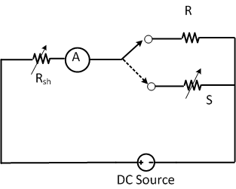
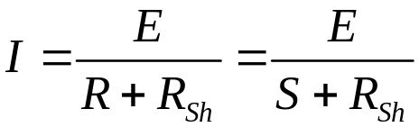

Measurement of medium resistance:
(1)Ammeter-voltmeter method
(2)Substitution method
(3)Wheatstone bridge method
(4)Carey-foster slidewire bridge method
Substitution method:

Slide 5
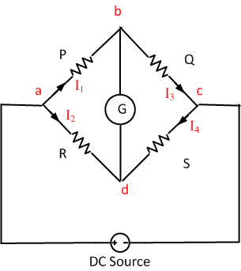



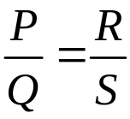
Wheatstone bridge method:
For measurement of resistance of motor windings, transformers, relay coils, and in the telephone companies to locate cable faults accurately
Under balanced condition:

Slide 6
Limitation:
The resistance of lead and contacts become significant while measuring low resistance (up to 5 ohm) and hence leads to error in measurement.
The current passing through bridge elements will be very less while measuring high resistance (in mΩ) and hence very difficult to detect the balanced condition due to sensitivity of galvanometer

Slide 7
Source of errors:
Limiting error of three known resistor.
Insufficient sensitivity of nulll detector
Change in resistor due to heating effect of current through resistor
Resistance of lead, contacts etc.
Thermal emf

Slide 8
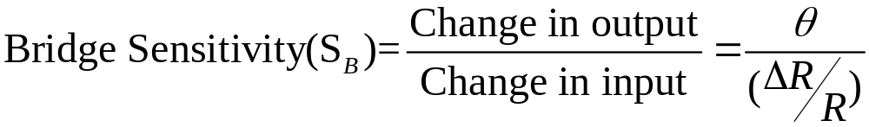
Sensitivity of bridge:

Slide 9
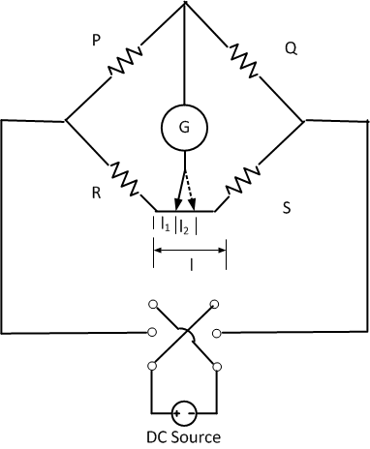
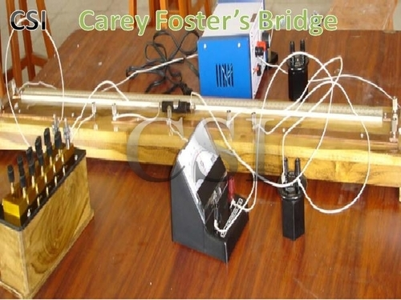

Carey-Foster slide wire bridge:
Specifically suited for two nearly equal resistance
Slide wire of length l and having resistance of r Ω/unit length is connected between R & S
Steps:
1) P & Q are adjust such that P/Q is nearly equal to R/S
2) Varies position of d on slide wire to get balance
Let balance is obtained at l₁ length from left

Slide 10
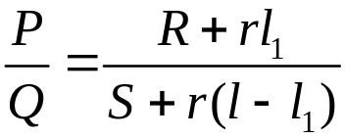
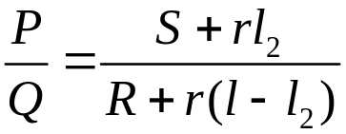
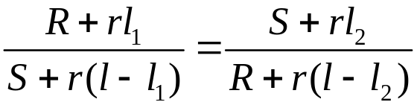
Carey-Foster slide wire bridge:
Let balance is obtained at l₁ length from left
Now interchange the position of R and S and obtain the balance and let balance is obtain at l₂

Slide 11
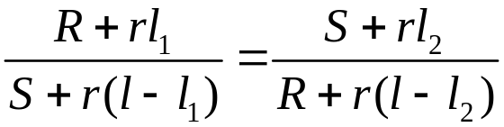
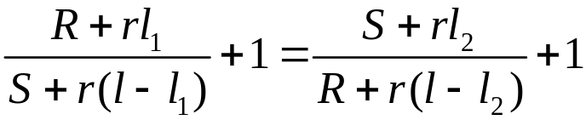
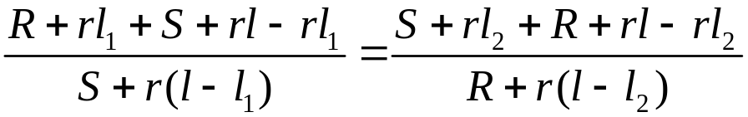

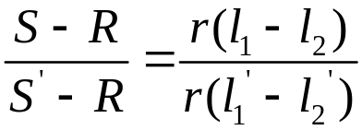


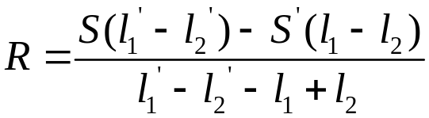
To eliminate the value of r S is shunted by known resistance such that the resultant resistance is S’ and then determine the difference in length and described above

Slide 12
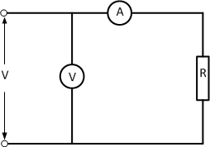
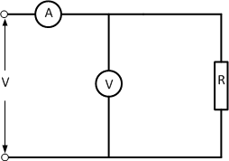
Example:
In the measurement of resistance, R, by the Ammeter-voltmeter method, connections as shown in the figure are used. The resistance of Ammeter is 0.01Ω and that of voltmeter 2000Ω. In case of (b) current measured is 2A and the voltage is 180V. Find the percentage error in calculating resistance R as a quotient of the reading and the true value of R. Also find the reading of voltmeter in case of (a) if the current indicated by the ammeter is 2A.

Slide 14
End

Slide 15
THANK YOU

