Slide 1
Subject: Electrical Machine-I
This Lecture contains
Three-phase Transformer

Slide 2
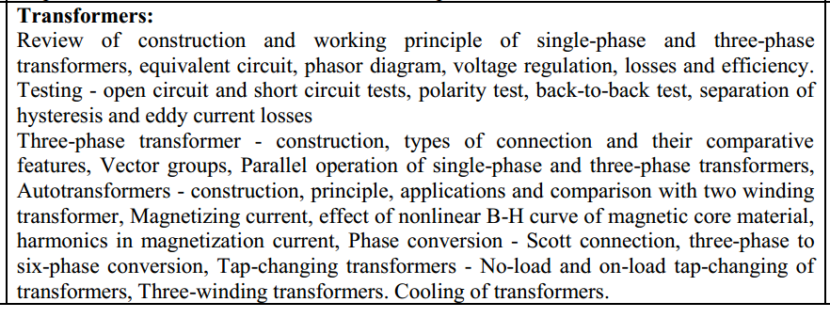
Syllabus.

Slide 3
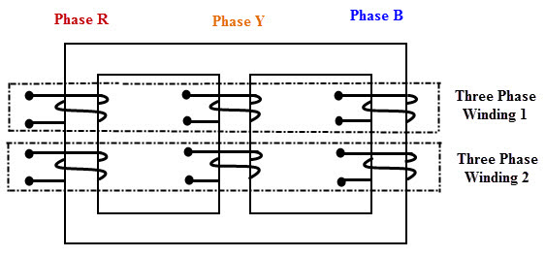
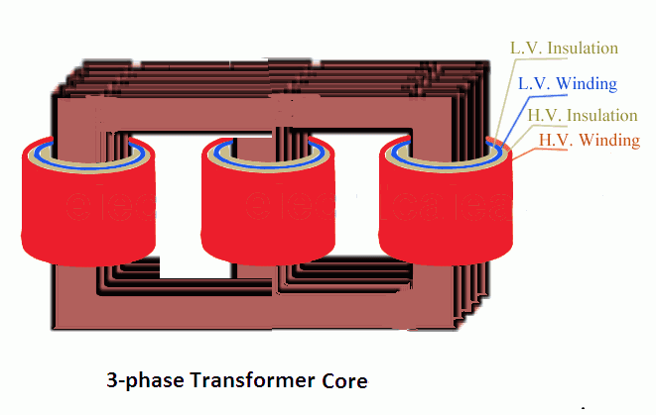
Three Phase Transformer:
The three phase transformer are used throughout in industry to change values of three-phase voltage and current. Three phase power is the most common way in which power is produced.
The basic working principle remain same as that of single phase transformer.

Slide 4
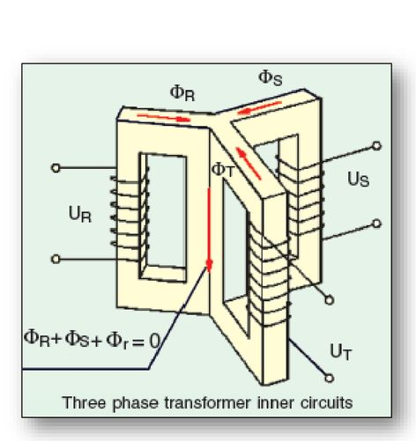
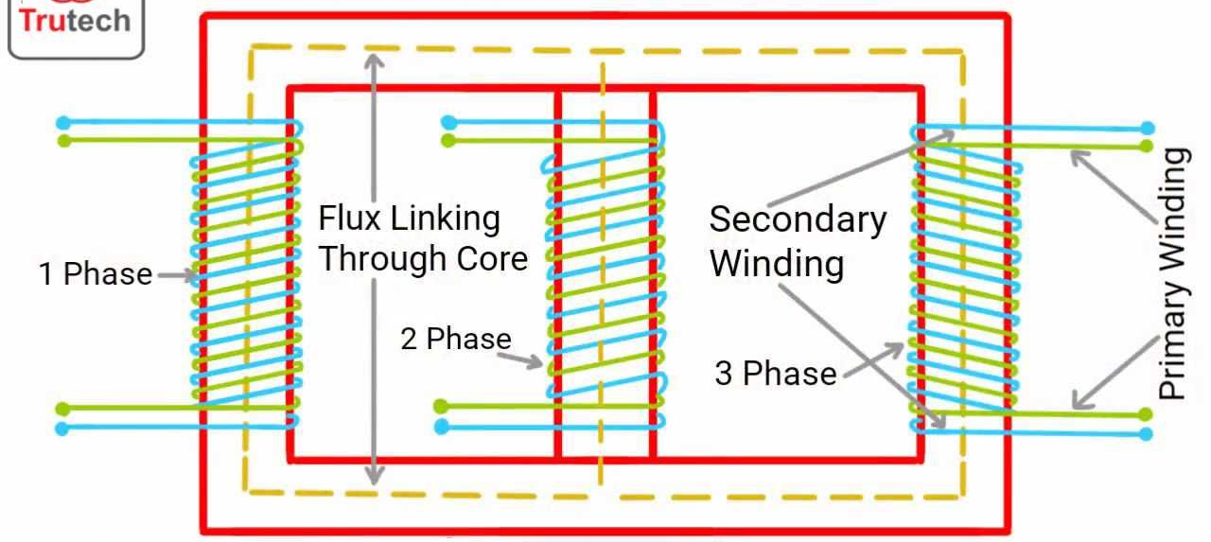
Three Phase Transformer:
As compared to a bank of three single phase transformer, the single unit of three-phase transformer occupies less floor space, weight reduction, cost reduction of about 15% and only one unit to be handled.
The center lag formed, carries the flux produced by the three phase current 120^{O} apart, hence the sum of three fluxes is also zero. Hence It will make no difference if the common leg is removed.

Slide 5
0,12
HV Line phasor (minutes)
Three Phase Transformer connection:
HV Side capital letter: D Y Z
LV Side small letter: d y z
Territory winding: y3 d3 z3
9
3
LV Line phasor (hours)
6

Slide 6
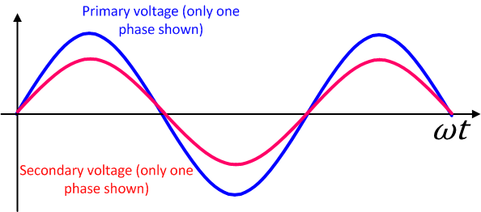
Three Phase Transformer connection:
Group 1
Connection: Yy, Dd, Dz
0,12
12 o clock (0⁰)
9
3
6

Slide 7
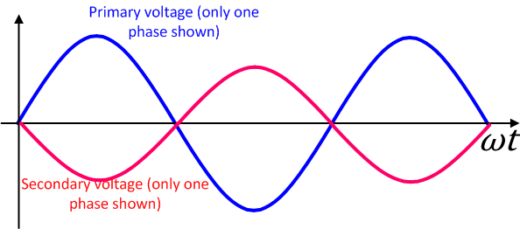
Three Phase Transformer connection:
Group 2
Connection: Yy, Dd, Dz
0,12
6 o clock (180⁰)
9
3
6

Slide 8
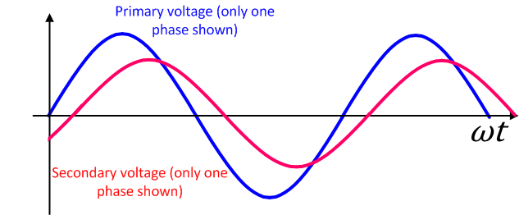
Three Phase Transformer connection:
Group 3
Connection: Dy, Yd, Yz
0,12
1 o clock (-30⁰)
9
3
6

Slide 9
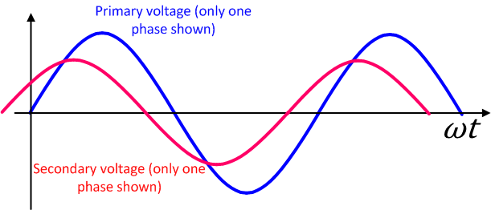
Three Phase Transformer connection:
Group 4
Connection: Dy, Yd, Yz
0,12
11 o clock (30⁰)
9
3
6

Slide 10
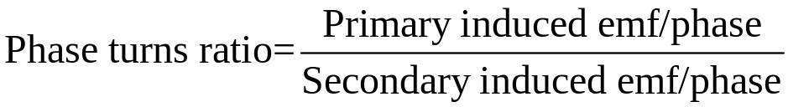
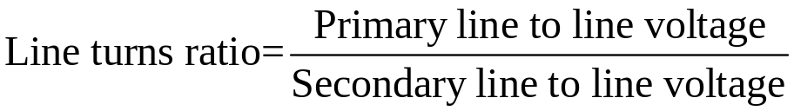






Group 1 YY0 or YY12
A₂
a₂
C₁
A₁
c₁
a₁
B₁
b₁
C₂
B₂
c₂
b₂

Slide 11
Group 1 YY6 or YY180
A₂
b₁
c₁
c₂
C₁
A₁
b₂
a₂
B₁
C₂
B₂
a₁

Slide 12
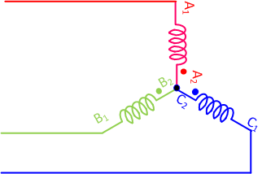
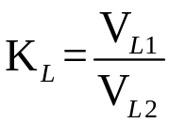
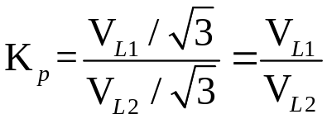
Features in YY connection
Reduction of phase voltage and hence Insulation requirement reduce.
Phase current is higher and hence cross section area is more.
Use of this connection in High voltage small current transformer

Slide 13
Disadvantages
As the transformer connection does not provide any closed path for 3rd harmonic component of current emf is sinusoidal only when 3 limbed core type transformer is used.
Problem of floating point neutral
It cannot supply unbalanced loads when not used with 3 limbed core type transformer
Source can supply only positive components
Remedies
Grounding primary and secondary neutrals along with source and load neutrals so that there is a closed path for 3rd harmonic and zero sequence components.
Using delta connection territory winding :
Makes the emf more sinusoidal
Stabilizes neutral point of YY transformer
Helps YY transformer to supply unbalance load effectively

Slide 14
Three Phase Transformer connection:
Group 1
Connection: Dd0, or Dd12
0,12
12 o clock (0⁰)
9
3
6

Slide 15
Group 1 Dd0 or Dd12
A₂
a₂
C₁
c₁
C₂
c₂
a₁
A₁
B₂
b₁
b₂
B₁

Slide 16
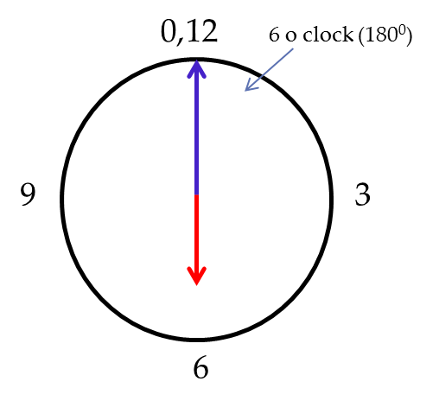
Group 1 Dd6
b₁
b₂
A₂
C₁
a₂
c₁
C₂
A₁
c₂
a₁
B₁
B₂

Slide 17




DD connection
More insulation required.
Less cross section of conductor
Less mech. Strength of winding
a => C => Vr
Can handle unbalance load
YY connection
Less Insulation required
More cross section of conductor
More mechanical strength of winding
a => C => Vr
Can’t handle unbalance load

Slide 18
Three Phase Transformer connection:
Group
Connection: Dy11
0,12
11 o clock (30⁰)
9
3
6

Slide 19
Group 2 Dy11
a₂
C₁
A₂
b₂
c₁
a₁
b₁
A₁
C₂
c₂
B₂
B₁

Slide 20
Three Phase Transformer connection:
Group
Connection: Dy1
0,12
1 o clock (30⁰)
9
3
6

Slide 21
Group 2 Dy1
a₂
A₂
B₁
c₂
a₁
c₁
b₁
A₁
B₂
b₂
C₂
C₁

Slide 22
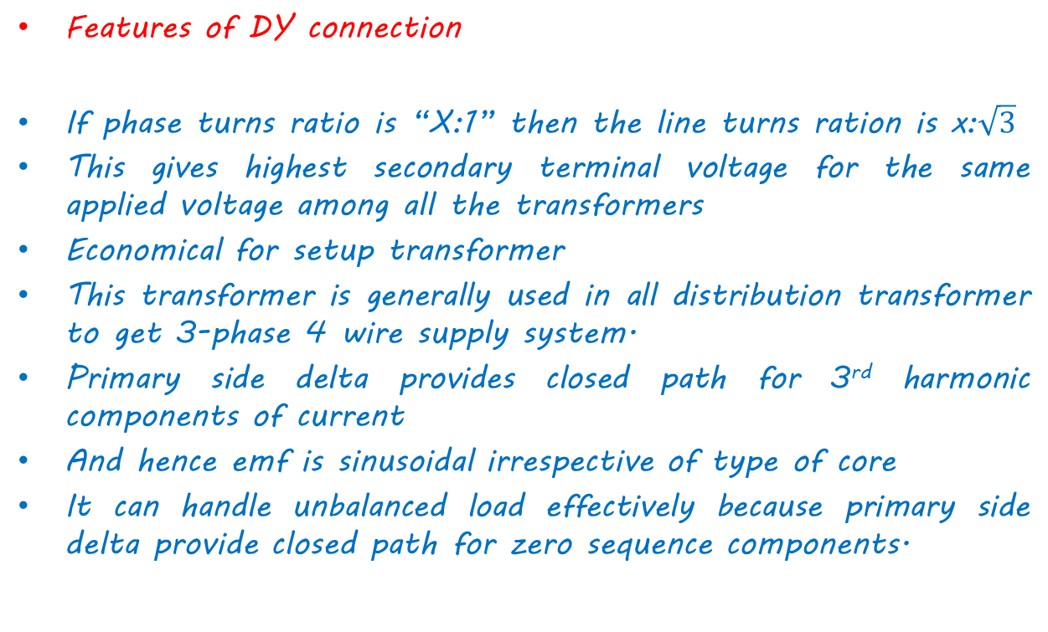
Features of DY connection
If phase turns ratio is “X:1” then the line turns ration is x:$\sqrt{3}$
This gives highest secondary terminal voltage for the same applied voltage among all the transformers
Economical for setup transformer
This transformer is generally used in all distribution transformer to get 3-phase 4 wire supply system.
Primary side delta provides closed path for 3rd harmonic components of current
And hence emf is sinusoidal irrespective of type of core
It can handle unbalanced load effectively because primary side delta provide closed path for zero sequence components.

Slide 23
Three Phase Transformer connection:
Group
Connection: Yd11
0,12
11 o clock (30⁰)
9
3
6

Slide 24
Group 2 Dy11
A₂
b₁
a₂
b₂
C₁
A₁
c₁
B₁
C₂
B₂
a₁
c₂

Slide 25
Three Phase Transformer connection:
Group
Connection: Dy1
0,12
1 o clock (30⁰)
9
3
6

Slide 26
Group 2 Dy11
A₂
a₂
b₁
C₁
A₁
B₁
b₂
c₁
C₂
B₂
a₁
c₂

Slide 27
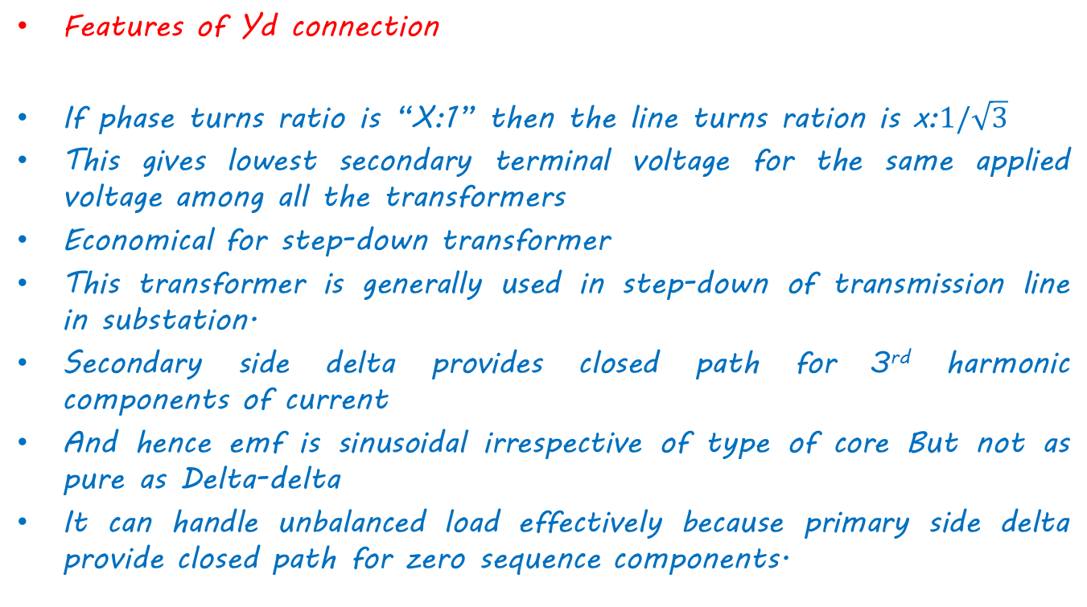
Features of Yd connection
If phase turns ratio is “X:1” then the line turns ration is x:$1/\sqrt{3}$
This gives lowest secondary terminal voltage for the same applied voltage among all the transformers
Economical for step-down transformer
This transformer is generally used in step-down of transmission line in substation.
Secondary side delta provides closed path for 3rd harmonic components of current
And hence emf is sinusoidal irrespective of type of core But not as pure as Delta-delta
It can handle unbalanced load effectively because primary side delta provide closed path for zero sequence components.

Slide 29
THANK YOU

