Slide 1
Introduction to the Karnaugh Map
J R Prajapati
Electrical Dept.
RNGPIT

Slide 2
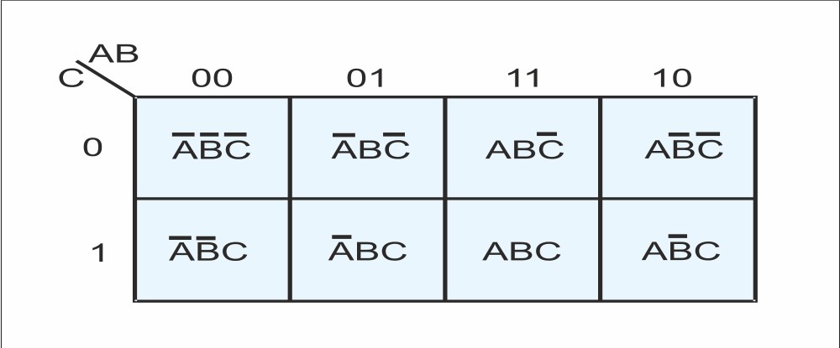
Karnaugh Maps
The Karnaugh map, or K-map, is a graphical technique for the representation and simplification of a Boolean expression.
The K-map is a two-dimensional form of the truth table, drawn in such a way that the simplification of a Boolean expression can be seen from the location of 1s on the map. A system with n variables has 2^{n} lines in its truth table and 2^{n} squares on its K-map. Each square on the K-map is associated with a line (i.e., minterm) in the truth table. Figure 1 shows a K-map for three variables.
The key to the Karnaugh map is the layout of the squares. Horizontally and vertically adjacent squares differ by only one variable. For example, in Figure 1 the leftmost two terms on the top line are A⋅B⋅C and A⋅B⋅C. The only difference between these terms is B and B.

Slide 3
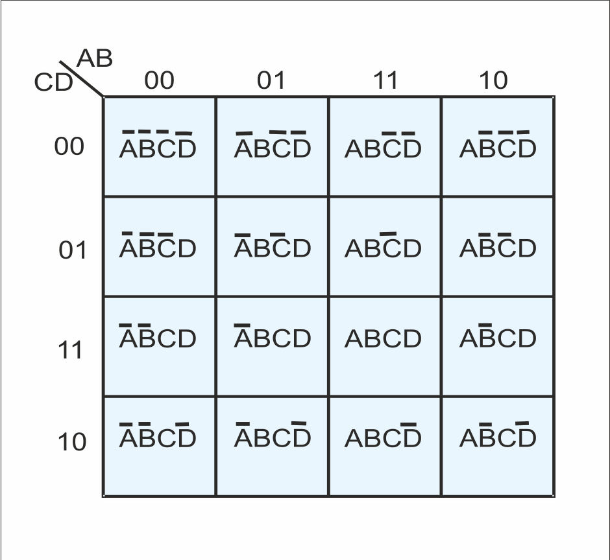
Figure 2 shows a K-map for four Variables where all the 16 minterms of a truth table appear.
It is easy to read a K-map. In Figure 2, the square with ABCD in it represents the minterm ABCD and falls in the AB column 01 and the CD row 11.
Figure 2 K-map for four variables

Slide 4
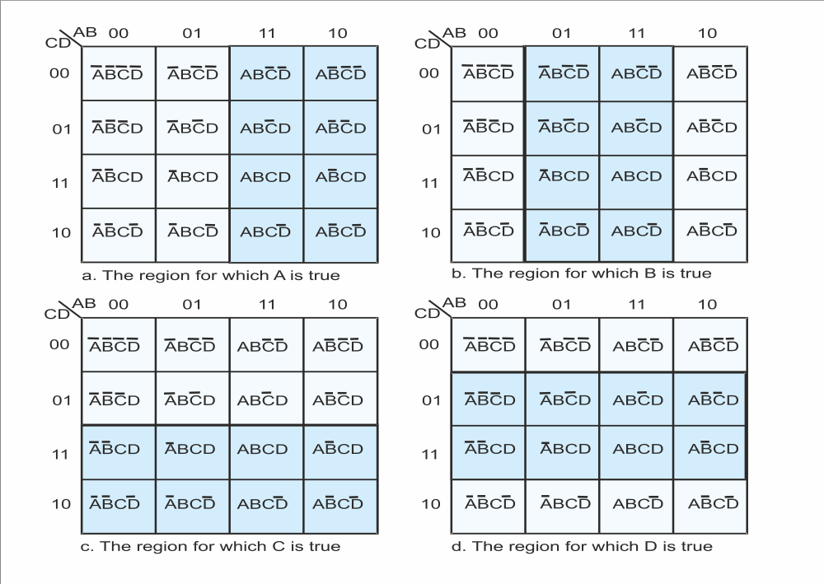
Figure 3 shows how a K-map can be interpreted in terms of the regions over which a variable is true or false. Here, the region on dark blue shows the region for which A, B, C, and D are true, respectively. The region in light blue corresponds to the region where a variable is false.
Figure 3 The regions of a K-map

Slide 5
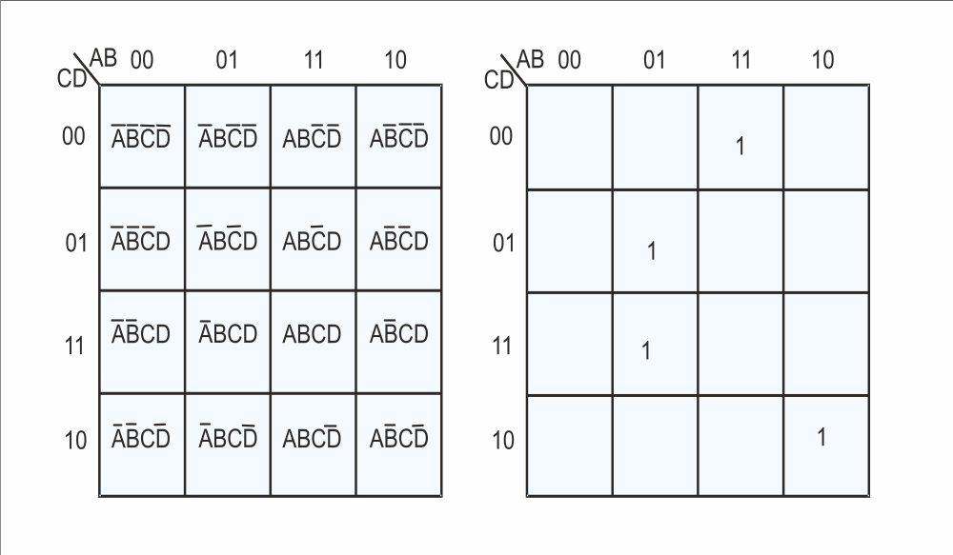
Figure 4 shows how we read a 4-variable K-map.
On the right-hand side we have a K-map with four minterms. These correspond to ABCD, ABCD, ABCD, and ABCD.
Figure 4 Reading a K-map

Slide 6
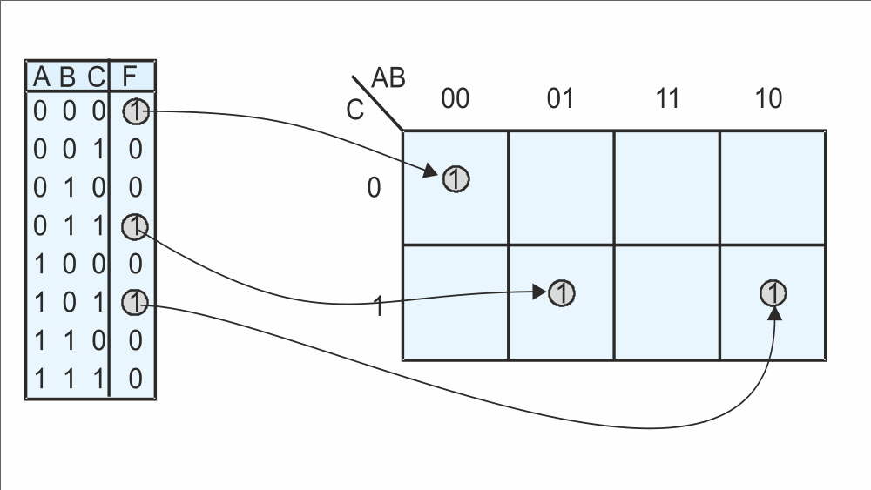
A three-variable K-map has four vertical columns, one for each of the four possible values of two out of the three variables. The leftmost column is labeled 00 and represents the region for which A = 0, B = 0. The next column is labeled 01, and represents the region for which A = 0, B = 1. The next column is labeled 11 and represents the region for which A = 1, B = 1. The fourth column, 10, represents the region for which A = 1, B = 0.
Figure 5 Plotting minterms on a K-map

Slide 7
The three-variable K-map below has two horizontal rows, the upper row corresponding to C = 0 and the lower to C = 1. Any square on this K-map represents a unique combination of the three variables in true or complemented form. The figure demonstrates how F = A⋅B⋅C + A⋅B⋅C +A⋅B⋅C is plotted. A square containing a logical 1 is said to be covered by a 1.
No two 1s plotted on the K-map are adjacent to each other, and that the function F = A⋅B⋅C + A⋅B⋅C + A⋅B⋅C cannot be simplified. Squares that do not contain a 1 are left unmarked even though they must contain a 0. .
Figure 5 Plotting minterms on a K-map

Slide 8
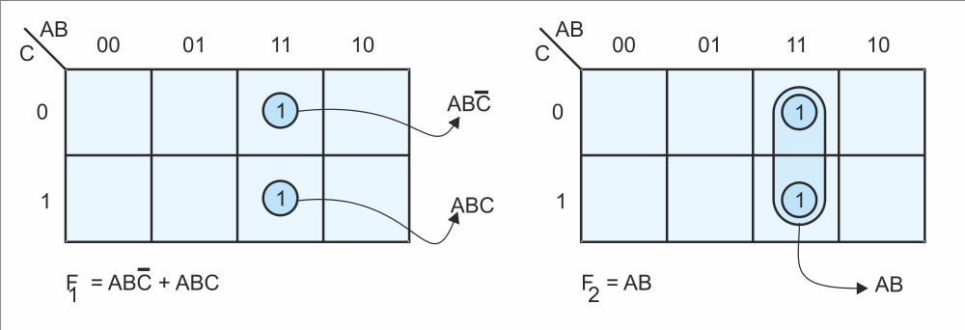
In the K-map for F₁ two adjacent squares are covered. Now look at the map for F₂ = A⋅B. A group of two squares is covered, corresponding to the column A = 1, B = 1. F₂ does not involve C, and a 1 is entered in the squares for which A = B = 1 and C = 0, and A = B = 1 and C = 1; i.e., a 1 is entered for all values of C for which AB = 11. When plotting a product term like A⋅B, you locate the region for which AB = 11.
The two K-maps are identical, so that F₁ = F₂ and A⋅B⋅C + A⋅B⋅C = A⋅B. Using Boolean algebra, A⋅B⋅C + A⋅B⋅C = A⋅B⋅(C + C) = A⋅B(1) = A⋅B. Two adjacent squares in a K-map can be grouped together to form a single simpler term.
Figure 6 Plotting two Boolean expressions on a K-map

Slide 9
Thank You!

